Slide 1

네트워크 OSPF, RIPV2, EIGRP발표
201795005 강용훈
201795055 안승현

Slide 2
목차
01
Topology
03
RIPV2
02
EIGRP
04
OSPF

Slide 3
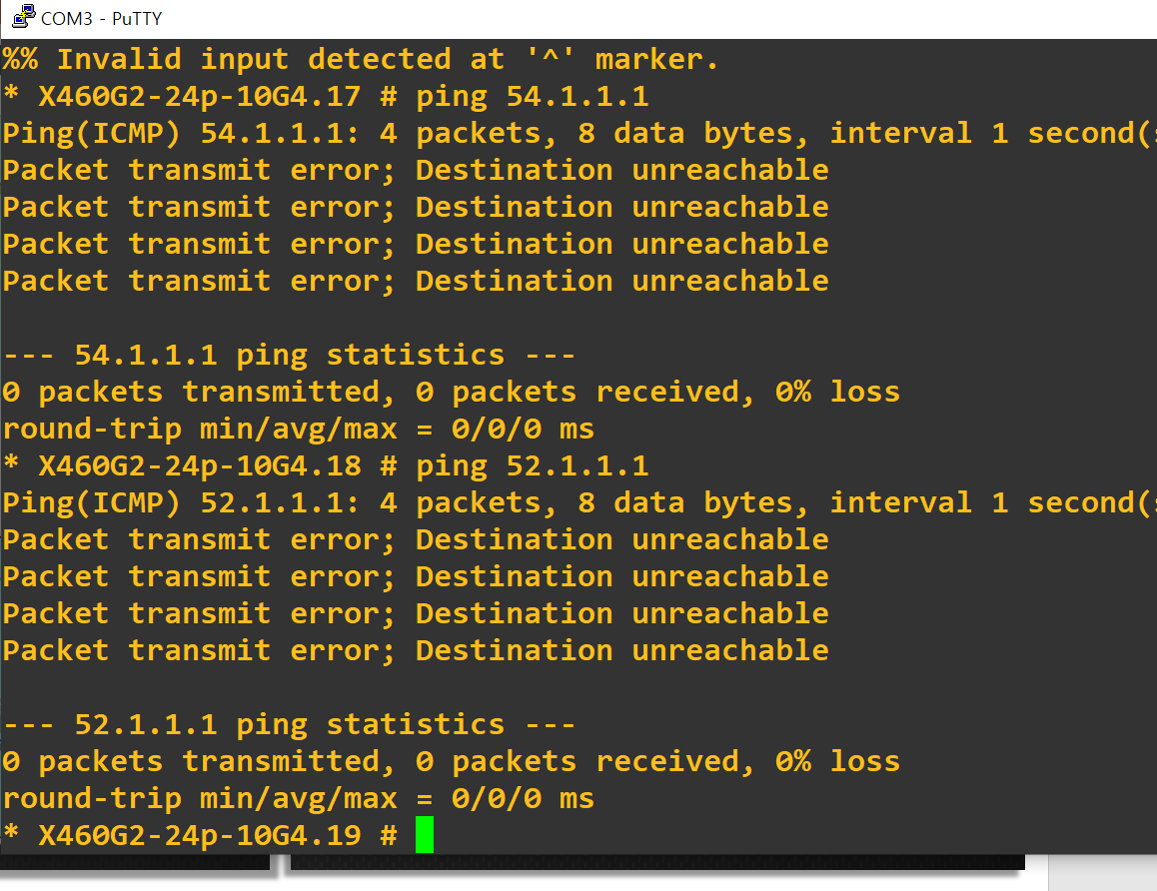
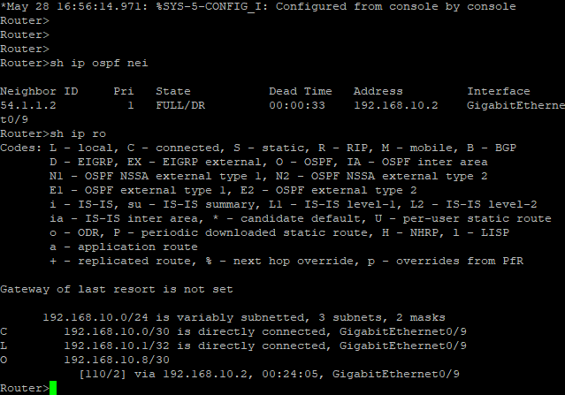
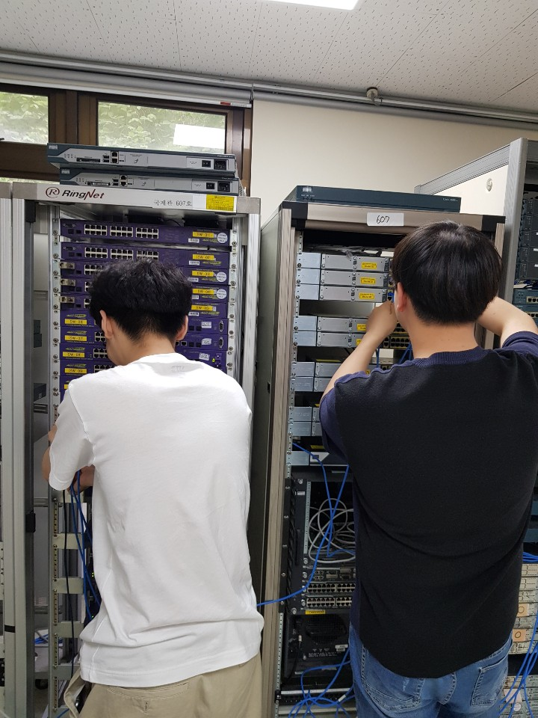
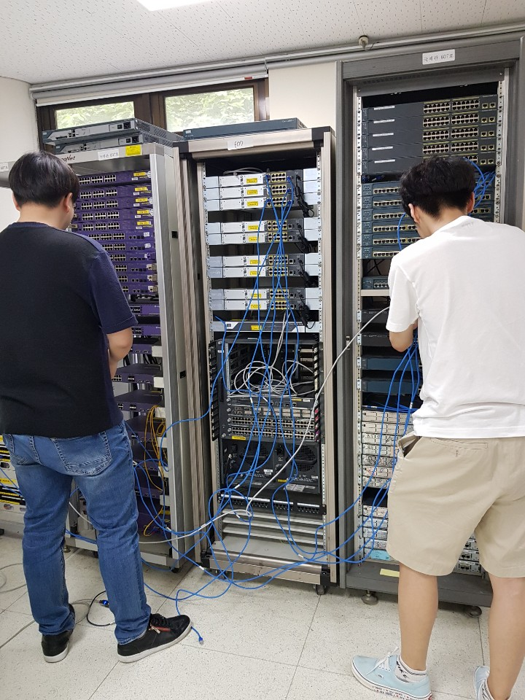
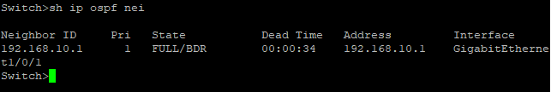
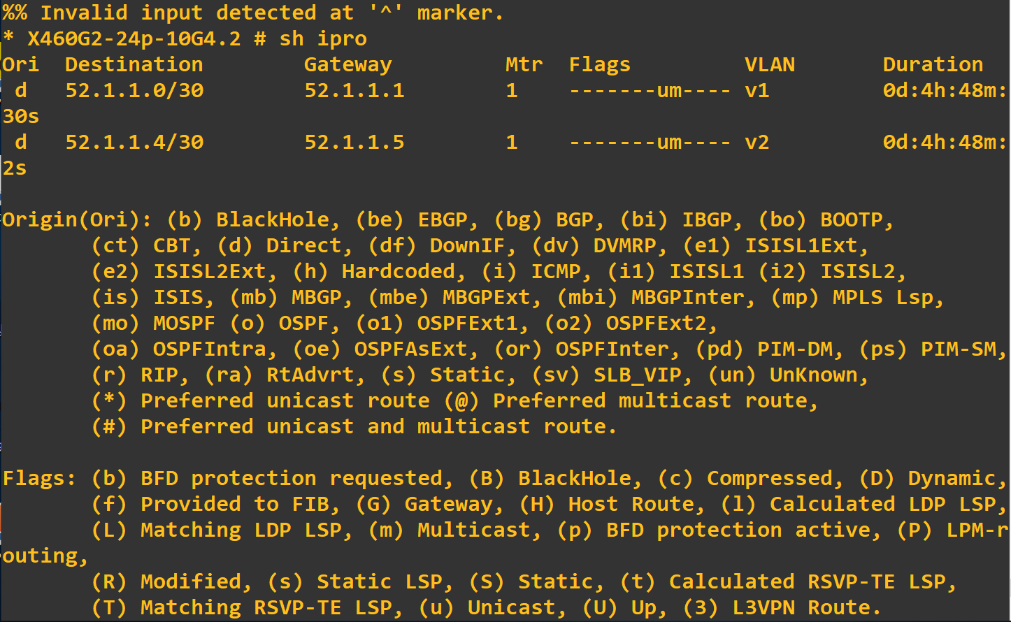
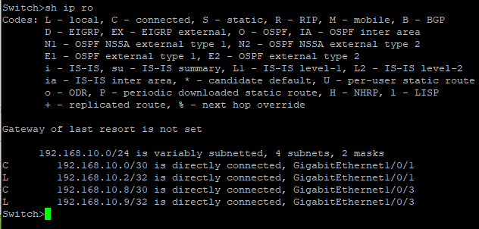
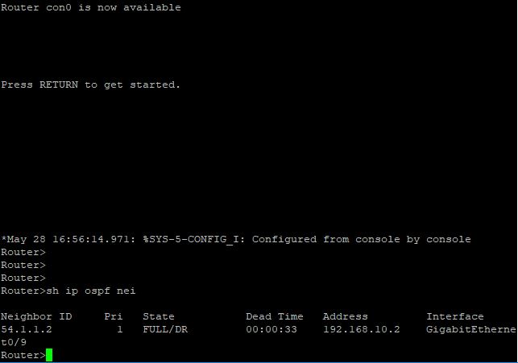
들어가며

Slide 4
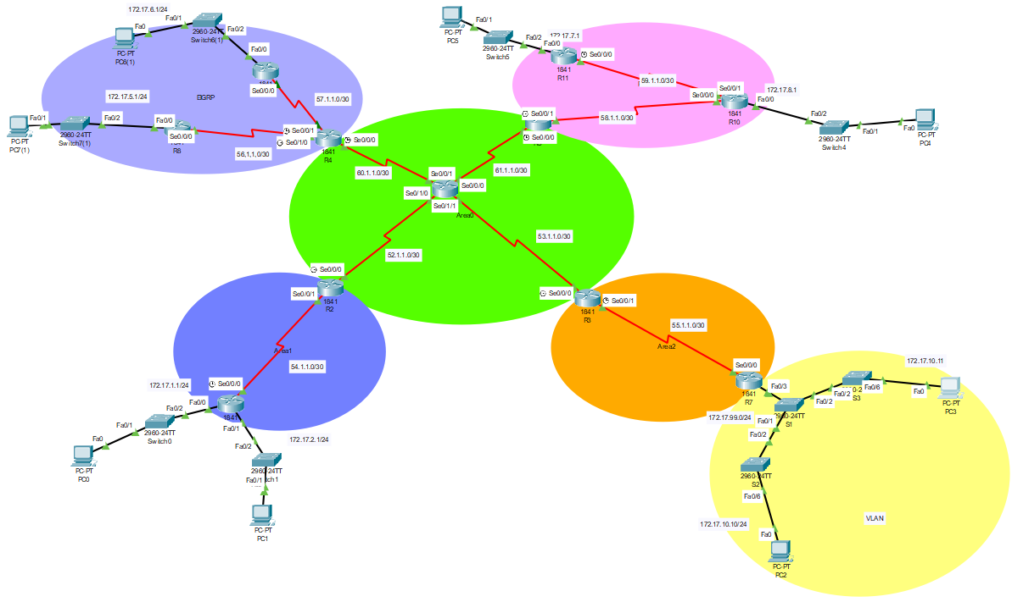
Topology
RIPV2
EIGRP
OSPF Area 0
OSPF Area 1
OSPF Area 2
VLAN

Slide 5
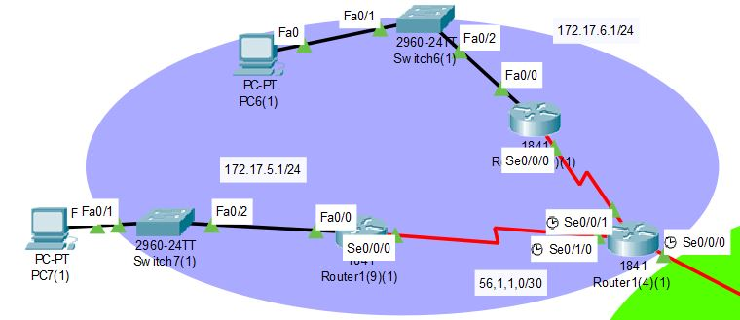
EIGRP
EIGRP 시스코 전용 프로토콜
네트워크의 변경이 있을 때마다 즉시 업데이트
주로 대형 서버에서 활용되는 방식이다.

Slide 6
Device | Interface | IP Address | Subnet Mask | Default Gateway
R4 | Se0/0/0 | 60.1.1.1 | 255.255.255.252 | N/A
 | Se0/0/1 | 57.1.1.2 | 255.255.255.252 | N/A
 | Se0/1/0 | 56.1.1.2 | 255.255.255.252 | N/A
R8 | Fa0/0 | 172.17.5.1 | 255.255.255.252 | N/A
 | Se0/0/0 | 56.1.1.1 | 255.255.255.252 | N/A
R9 | Fa0/0 | 172.17.6.1 | 255.255.255.252 | N/A
 | Se0/0/0 | 57.1.1.1 | 255.255.255.252 | N/A
PC6 | NIC | 172.17.6.10 | 255.255.255.0 | 172.17.6.1
PC7 | NIC | 172.17.5.10 | 255.255.255.0 | 172.17.5.1

Slide 7
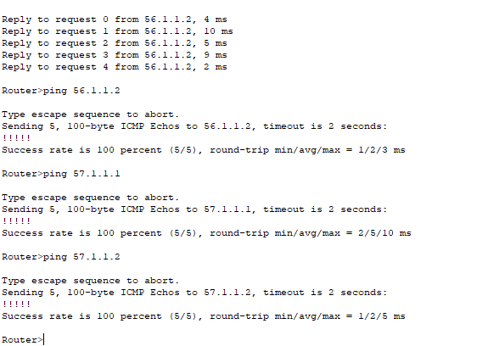
EIGRP
내부망 핑 결과

Slide 8
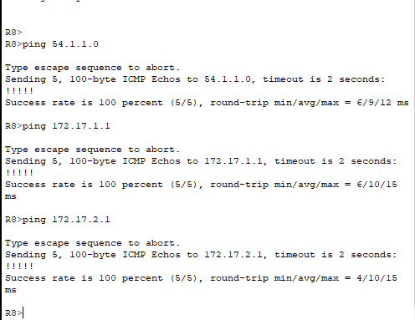
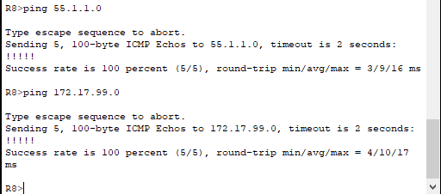
EIGRP
외부망 핑 결과
EIGRP->OSPF(area1)
EIGRP->OSPF(area2)

Slide 9
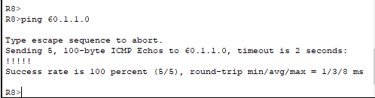
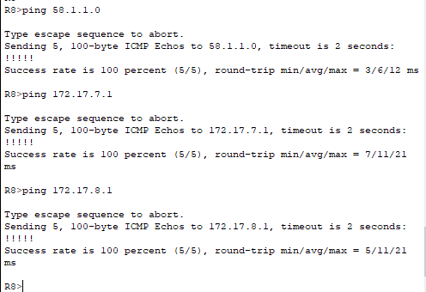
EIGRP
외부망 핑 결과
EIGRP->OSPF(area0)
EIGRP->RIPV2

Slide 10
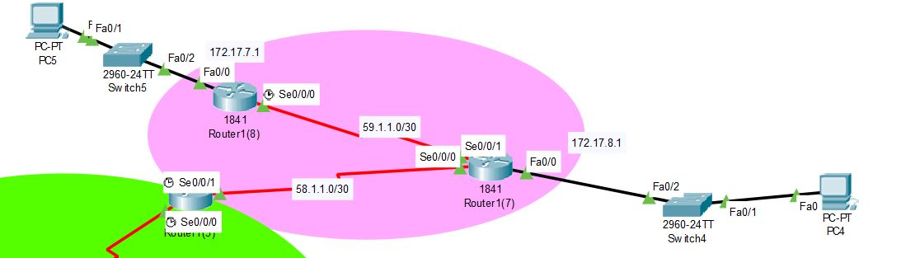
RIPV2
RIPV2망
립은 설정이 간단해서 소규모의 네트워크에서 많이 쓰인다 적은 자원소모
R1(7) network 172.17.0.0
router rip passive-interface fa0/0
version 2
network 58.0.0.0
network 59.0.0.0

Slide 11
Device | Interface | IP Address | Subnet Mask | Default Gateway
R5 | Se0/0/0 | 61.1.1.1 | 255.255.255.252 | N/A
 | Se0/0/1 | 58.1.1.2 | 255.255.255.252 | N/A
R10 | Fa0/0 | 172.17.8.1 | 255.255.255.252 | N/A
 | Se0/0/0 | 58.1.1.1 | 255.255.255.252 | N/A
 | Se0/0/1 | 59.1.1.2 | 255.255.255.252 | N/A
R11 | Fa0/0 | 172.17.7.1 | 255.255.255.252 | N/A
 | Se0/0/0 | 59.1.1.1 | 255.255.255.252 | N/A
PC4 | NIC | 172.17.8.10 | 255.255.255.0 | 172.17.8.1
PC5 | NIC | 172.17.7.10 | 255.255.255.0 | 172.17.7.1

Slide 12
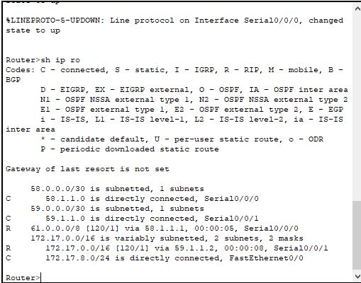
RIPV2
내부망 핑 결과

Slide 13
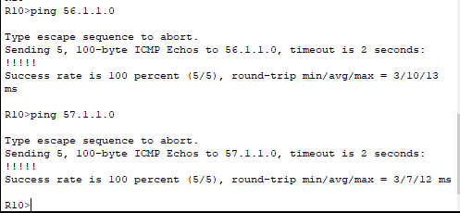
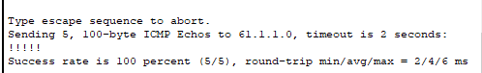
RIPV2
외부망 핑 결과
RIPV2->EIGRP
RIPV2->OSPF(area0)

Slide 14
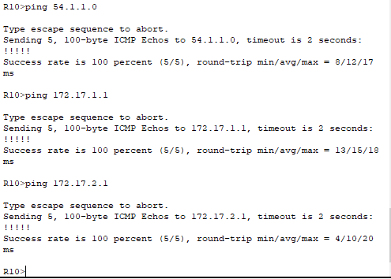
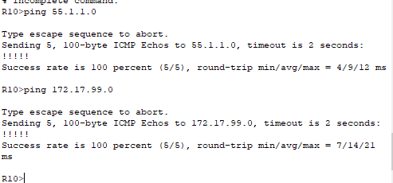
RIPV2
외부망 핑 결과
RIPV2->OSPF(area1)
RIPV2->OSPF(area2)

Slide 15
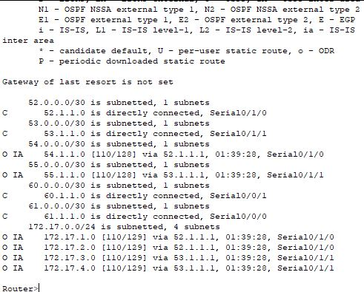
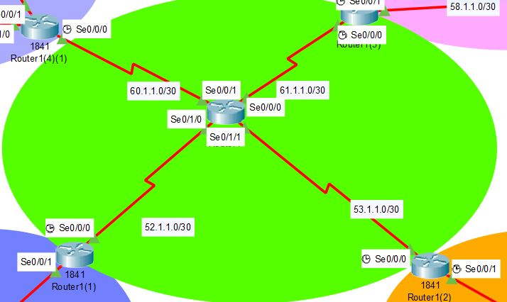
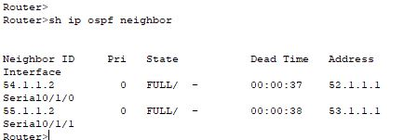
router ospf 1
network 52.1.1.0 0.0.0.3 area 0
network 53.1.1.0 0.0.0.3 area 0
OSPF
OSPF AREA 0
router rip
redistribute ospf 1 metric 4
router ospf
redistribute rip subnets

Slide 16
Device | Interface | IP Address | Subnet Mask | Default Gateway
R1 | Se0/0/0 | 53.1.1.2 | 255.255.255.252 | N/A
 | Se0/0/1 | 61.1.1.2 | 255.255.255.252 | N/A
 | Se0/1/1 | 52.1.1.2 | 255.255.255.252 | N/A
 | Se0/1/0 | 60.1.1.2 | 255.255.255.252 | N/A

Slide 17
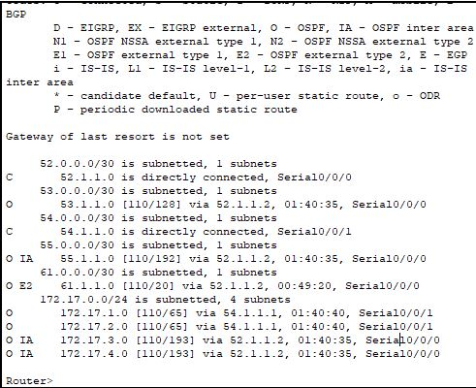
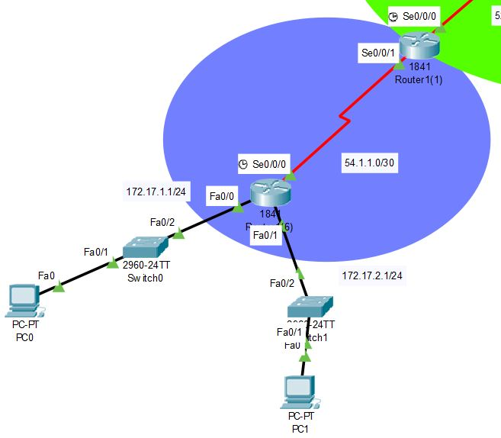
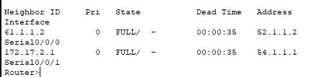
OSPF
OSPF Area 1
router ospf 1
network 54.1.1.0 0.0.0.3 area 1
network 172.17.1.0 0.0.0.255 area 1

Slide 18
Device | Interface | IP Address | Subnet Mask | Default Gateway
R2 | Se0/0/0 | 52.1.1.1 | 255.255.255.252 | N/A
 | Se0/0/1 | 54.1.1.2 | 255.255.255.252 | N/A
1841 | Fa0/0 | 172.17.1.1 | 255.255.255.0 | N/A
 | Fa0/1 | 172.17.2.1 | 255.255.255.0 | N/A
 | Se0/0/0 | 54.1.1.1 | 255.255.255.252 | N/A
PC0 | NIC | 172.17.1.10 | 255.255.255.0 | 172.17.1.1
PC1 | NIC | 172.17.2.10 | 255.255.255.0 | 172.17.2.1

Slide 19
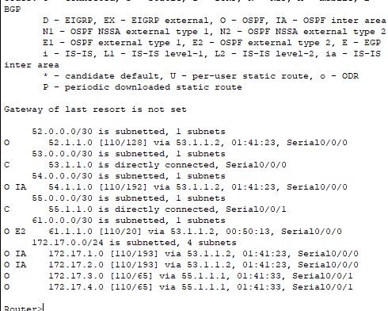
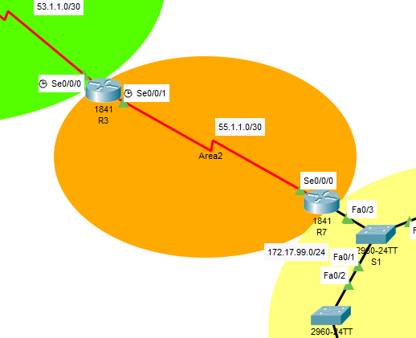
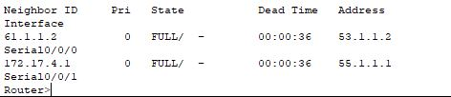
OSPF
OSPF Area 2
router ospf 1
network 55.1.1.0 0.0.0.3 area 2
network 172.17.3.0 0.0.0.255 area 2

Slide 20
Device | Interface | IP Address | Subnet Mask | Default Gateway
R3 | Se0/0/0 | 53.1.1.1 | 255.255.255.252 | N/A
 | Se0/0/1 | 55.1.1.2 | 255.255.255.252 | N/A
R7 | Fa0/3 | 172.17.99.0 | 255.255.255.0 | N/A
 | Se0/0/0 | 55.1.1.1 | 255.255.255.252 | N/A

Slide 21
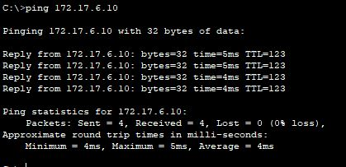
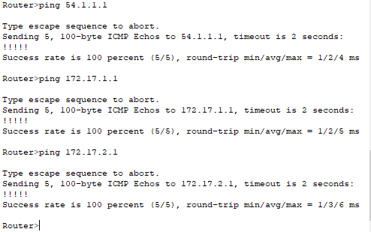
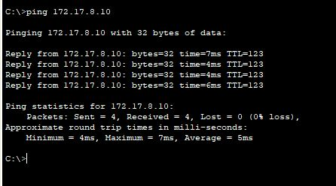
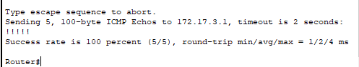
OSPF
OSPF 핑 결과

Slide 22
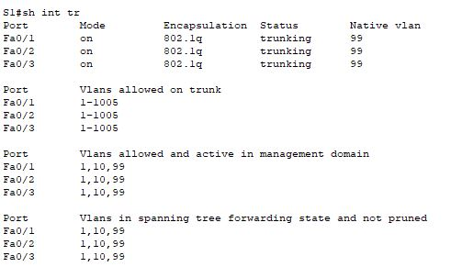
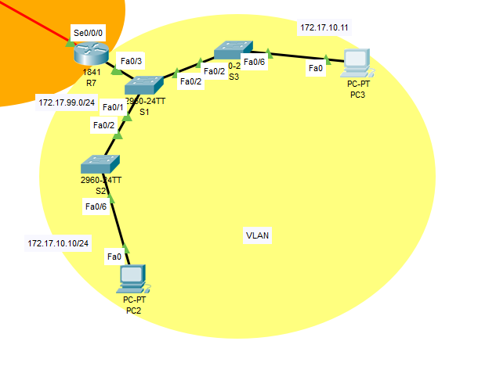
VLAN
Notes:
Vlan 이란 Virtual Local Area Network 의 약자로 물리적 배치와 상관없이 논리적으로 LAN을 구성할 수 있는 기술

Slide 23
Device | Interface | IP Address | Subnet Mask | Default Gateway
PC2 | NIC | 172.17.10.10 | 255.255.255.0 | 172.17.10.1
PC3 | NIC | 172.17.10.11 | 255.255.255.0 | 172.17.10.1

Slide 24
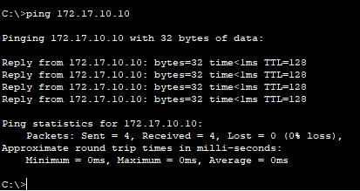
VLAN
VLAN 핑 결과
Notes:
Vlan 이란 Virtual Local Area Network 의 약자로 물리적 배치와 상관없이 논리적으로 LAN을 구성할 수 있는 기술

Slide 25
감사합니다
감사합니다

